Slide 1
The Enhanced Sequential Intercept Model (E-SIM): New Mexico’s Public Health Approach to Mapping the Behavioral Health System Esperanza Lucero & Annette Crisanti, PhD

Slide 2
Behavioral Health Reform and Investment Act (SB3)
Section 4. Regional Plan – Sequential Intercept Mapping (SIM)
A. The administrative office of the courts shall coordinate regional meetings, complete sequential intercept mapping and coordinate the development of regional plans.

Slide 3
The NM E-SIM
1. The Addition of a Pre-Intercept: Community Prevention Services
Not all individuals with mental illness (MI) and/or substance use disorders (SUD) encounter the justice system. Therefore, when mapping services within the community, it is important to assess the availability – and gaps – in Community Prevention Services that aim to support all individuals who may never have justice system involvement.
2. The Addition of a Process to Support Mapping of the Youth System
It is essential to understand the availability of – and gaps in – services for youth who are at risk or living with MI and/or SUDs. Mapping these services helps ensure early identification and support.
3. The E-SIM Focuses on Prevention and Early Intervention
Using a public health framework, the E-SIM focuses on improving the health and well-being of all New Mexicans by identifying opportunities – and gaps – for intervention that could prevent initial involvement or deeper penetration into the healthcare or justice system.

Slide 4
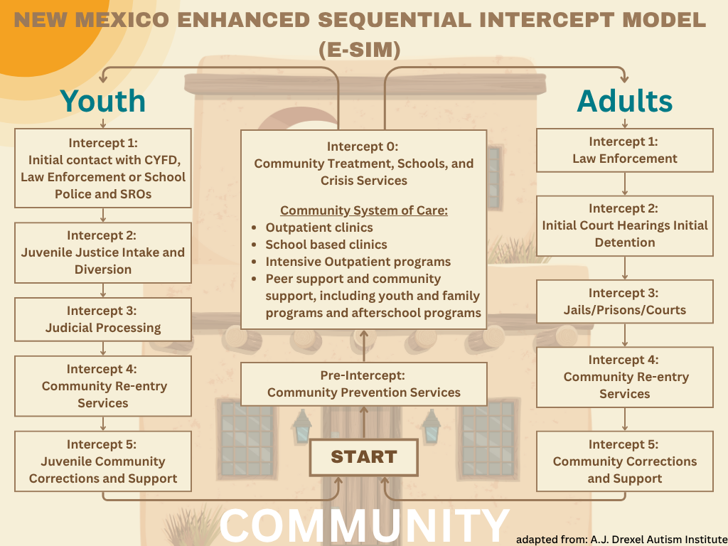

Slide 5
Pre Intercept: Community Prevention Services
Proactive initiatives designed to address the root causes of social problems like substance misuse, crime, and mental health challenges within a community, ideally before they escalate to require more intensive interventions such as contact with the justice or behavioral healthcare systems. The goal of these public health programs are to strengthen protective factors and reduce risk factors that contribute to negative outcomes.
Youth System School-based programs that focus on social emotional learning, substance abuse prevention, and mental health awareness Family and parenting support groups Screening for BH problems in primary care settings | Adult System Support Groups Employment and Social Support Services Housing Assistance Screening for BH problems in primary care settings MHFA
Notes:
Prevent the onset or escalation of behavioral health problems before any crisis or justice involvement occurs.

Slide 6
Intercept 0: Community Treatment, Schools and Crisis Services
The early intervention points for people with mental illness and/or substance use disorders before law enforcement or justice system involvement, focused on intervening with individuals already showing signs of behavioral health crisis or need.
Youth System 988 crisis lines Mobile crisis teams Peer support and harm reduction services Crisis triage center Drop-in behavioral health centers | Adult System 988 crisis lines Mobile crisis teams Peer support and harm reduction services Crisis triage center Drop-in behavioral health centers
Notes:
Divert individuals from justice system entry by intervening early in a crisis or behavioral health event.

Slide 7
Intercept 1: The First Point of Contact with the Justice System, CYFD, School Police or SROs
Youth System: Initial Contact with CYFD, Law Enforcement, or School Police and School Resource Officers (SROs) Involves diversion performed by law enforcement, school police, and SROs. This intercept also involves informal sanctions by CYFD, including diversion programs, referral to Teen Court, and non-court-ordered supervision. Allows youth to be diverted into treatment instead of being referred to the Children’s Court Attorney or detained. | Adult System: Law Enforcement Involves diversion performed by law enforcement and other emergency service providers who respond to people with mental and substance use disorders. Allows people to be diverted to treatment instead of being arrested or booked into jail. Examples include, pre-booking jail diversion programs, crisis intervention teams (trained officers), co-responder teams (clinician + officer).

Slide 8
Intercept 2: Identifying Individuals with BH Needs Early in Court Processing
Youth System: Juvenile Justice Intake and Diversion By statute, some youth must be referred directly to the CCA by CYFD; CYFD can choose to refer other youth to the CCA. CCAs can dismiss charges, divert youth into community-based programs, or refer youth back to CYFD with informal recommendations for services. | Adult System: Initial Court Hearings Initial Detention Involves diversion to community-based treatment by jail clinicians, social workers, or court officials during jail intake, booking, or initial hearing. Examples include, mental health screening at jail intake, pre-trial diversion programs

Slide 9
Intercept 3: Involvement in Court Proceedings (Arraignment, Trial)
Youth System: Judicial Processing Involves placement in community programs as alternatives to juvenile detention. Also includes consent decrees that allow dismissal of charges following completion of specified actions, including treatment. | Adult System: Jails/Prisons/Courts Involves diversion to community-based services through jail or court processes and programs after a person has been booked into jail. Includes services that prevent the worsening of a person’s illness during their stay in jail or prison. Examples include mental health or drug courts, jail-based BH services, competency restoration programs, court-ordered treatment plans.

Slide 10
Intercept 4: The Transition from Incarceration to Community
Youth System: Community Re-Entry Services Involves Juvenile Justice Transitions Services and CYFD supervised release panels to provide supported reentry back into the community after leaving juvenile correctional facilities. Transition service coordinators (TCs) link youth and individuals who have come of age to various services, including behavioral and mental health services. | Adult System: Community Re-Entry Services Involves supported re-entry back into the community after jail or prison to reduce further justice involvement of people with mental and substance use disorders. Involves reentry coordinators, peer support staff, or community in-reach to link people with proper mental health and substance use treatment services. Examples include, re-entry planning teams, medication continuity, housing support, warm hand-offs.

Slide 11
Intercept 5
Youth System: Juvenile Community Corrections and Support Involves mandated youth supervision by juvenile probation to reduce further justice involvement of youth. Also involves Juvenile Community Corrections (JJC) to provide individualized supports for youth to prevent violations or offenses that may extend connection to the juvenile correctional system. | Adult System: Community Corrections and Support Involves community-based justice supervision with added supports for people with mental and/or substance use disorders to prevent violations or offenses that may result in another jail or prison stay.

